Slide 1

18CSA392
MINOR PROJECT
Correlation and Association Mining Based Network using Different Network Centrality Measures and Stock Prediction – Indian Stock Exchange

Slide 2





GUIDE
Mrs. Jisha R C Department of Computer Science Applications
TEAM MEMBERS
Achu Pushpan
(AM.SC.U3CSC19004)
Ashish Arvind Suryawanshi
(AM.SC.U3CSC19021)
Hareendran V
(AM.AR.U317BCA033)
Harinandanan N (AM.SC.U3CSC19034)
Midhun Manu (AM.SC.U3CSC19047)

Slide 3
ABSTRACT OF THE PROJECT
Network Science has become an ever increasing and interesting field of research in the recent decade by focusing on finding hidden knowledge in complex networks.
This study of complex relationships in network structures has also gained a lot of interest in the world of finance and economy.
There is a direct relation between the growth of stock market and the growth of Indian economy of a country.
The proposed work focuses on the analysis in Indian Stock Market and the relationship between different sectors, looking into the market price indices data of different market sectors and their fluctuations over time.

Slide 4
PROJECT SCOPE
The analysis of stock market can be used to evaluate the changes that occur in the Indian economy. That is, on analyzing different indices in the stock market, we can identify which sector has more growth in Indian Stock Market.
Upon applying our algorithm over the Time Series data, we can predict future Stock price fluctuations from historical data.
Using this tool, we can determine the effect of sentimental analysis.
Effects of Pandemic in the Indian Stock Market can be analyzed using this tool.

Slide 5
ARCHITECTURE
Work Flow of Proposed Project

Slide 6
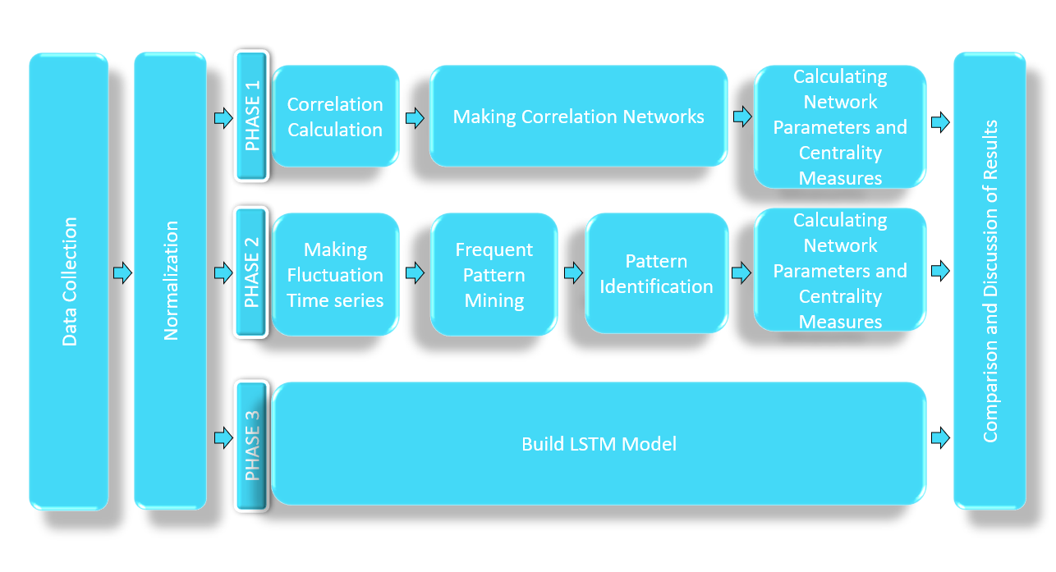

Slide 7
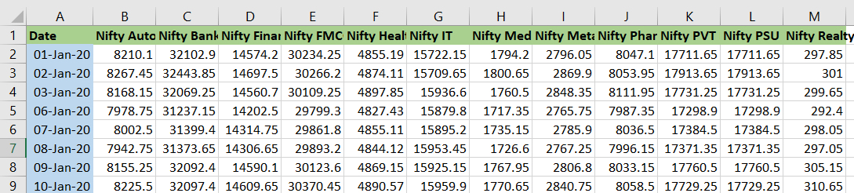
DATA COLLECTION
Data for market sector price indices are gathered from the official website of NSE India.
Website : https://www1.nseindia.com/products/content/equities/indices/historical_index_data.htm
Data gathered are for the period of 1st January 2020 to 31st December 2020.
Considering the missing data (national holidays), 251 daily stock sector index data were gathered for 12 market sectors.
Data for stock prediction using LSTM algorithm is collected from the website of Yahoo Finance.
Website : https://finance.yahoo.com/
Data gathered are for the period of 1st January 2010 to 31st December 2019.
stock.csv

Slide 8
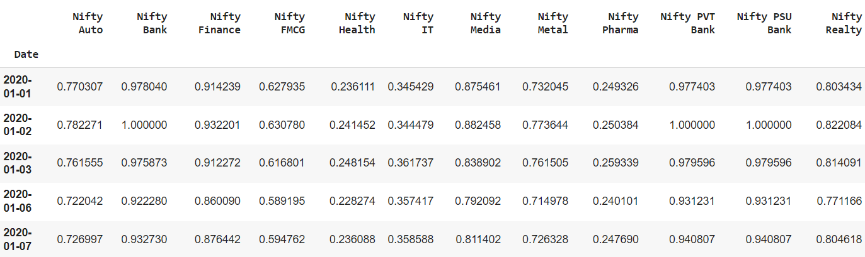
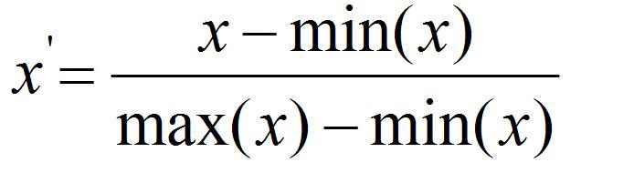
NORMALIZATION
Normalization is used to scale the data of an attribute so that it falls in a smaller range, such as -1.0 to 1.0 or 0.0 to 1.0.
Min-Max Normalization
Minimum and maximum value from data is fetched and each value is replaced according to the following formula.
normalized_stock

Slide 9
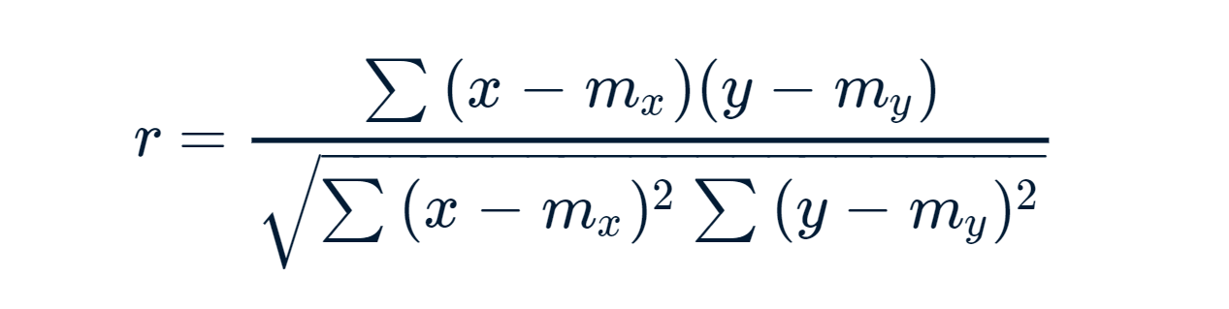
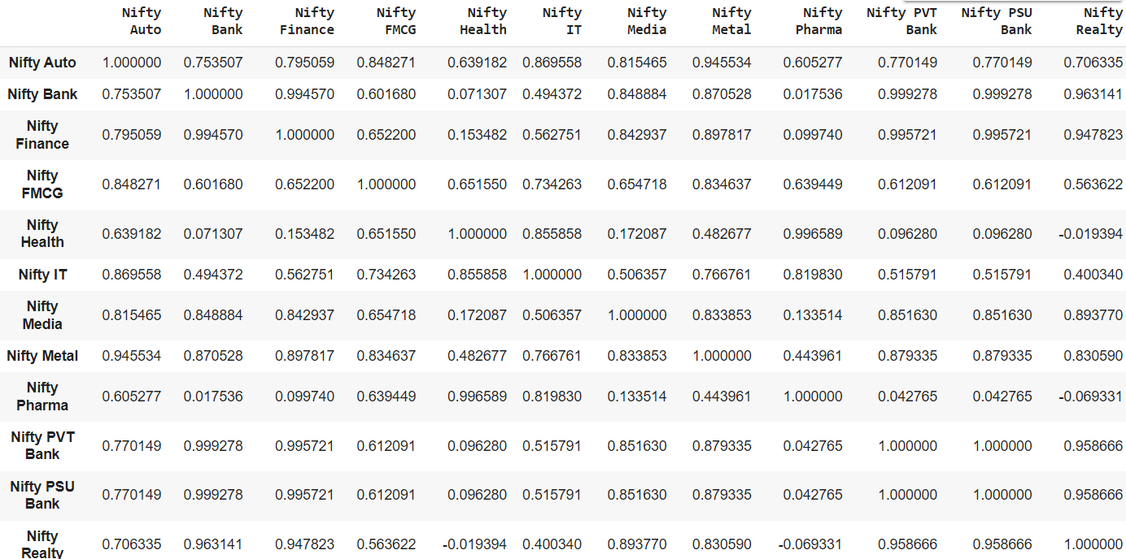
CORRELTION CALCULATION
Used to measure how strong a relationship is between two variables.
Correlation, r is a digit between -1 and +1.
r > 0 Positive Correlation
r = 0 No Correlation
r < 1 Negative Correlation

Slide 10
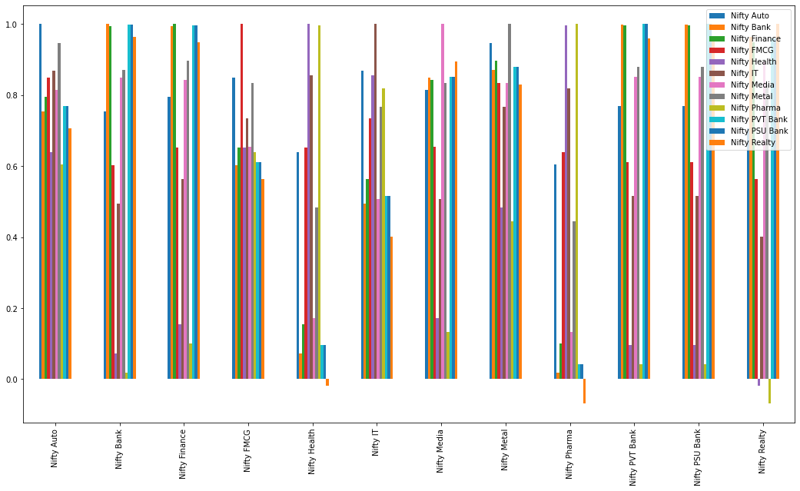

Slide 11
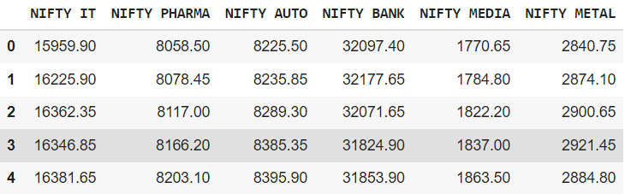
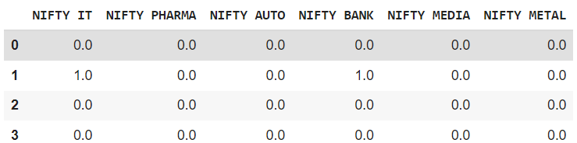
MAKING FLUCTUATION TIME SERIES
Dataset is converted into a fluctuating binary dataset with zeros and ones.
A rise in the value of the stock sector index from the previous value in the time series is represented by a 1, and a 0 indicates a fall in the value.
Converting the dataset for using in Apriori Algorithm

Slide 12
FINDING FREQUENT PATTERNS
Pattern Identification is done by Association Rule Mining.
Association rules, present the relationship between different item sets in terms of occurrence.
The patterns found by Association Rule Mining represent relationships between the sectors.
Rules like 𝐴 → 𝐵 indicate that if sector A rises with a specific confidence and support value, the sector index B also rises.
Apriori is the name of a famous algorithm to find association rules in a dataset.

Slide 13
STEPS FOR APRIORI ALGORITHM
STEP 1 :
Determine the support of itemsets in the transactional database, and select the minimum support and confidence.
STEP 2 :
Take all supports in the transaction with higher support value than the minimum or selected support value.
STEP 3 :
Find all the rules of these subsets that have higher confidence value than the minimum confidence.

Slide 14
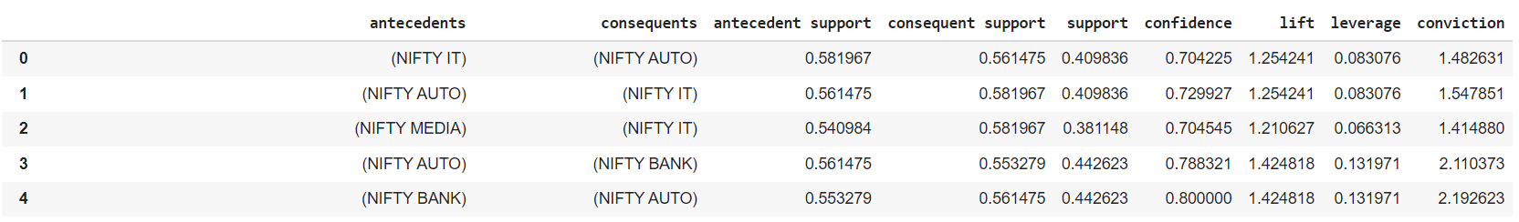
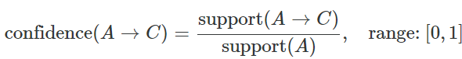
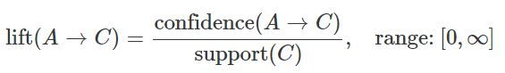
Antecedents :
If Component of an Association rule is Known as Antecedents.
Consequents :
Then Component is known as Consequents
Antecedent Support : It computes the proportion of transactions that contain the antecedent.
Consequent Support : It computes the proportion of transactions that contain the consequent.
Support :
It indicates how frequently the items in the rule occur together.
Confidence :
It is the ratio of the rule support to the number of transactions that include the antecedent.
Lift :
It is used to measure how much more often the antecedent and consequent of a rule A->C occur together than we would expect if they were statistically independent.

Slide 15
CONSTRUCTION OF CORRELATED AND APRIORI NETWORK
Correlated and Apriori network is constructed using NetworkX Library.
It is used for graph representation in python.
Using two threshold values, Two Undirected Correlated Networks and two Directed Apriori networks are constructed.

Slide 16
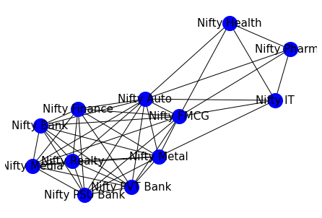
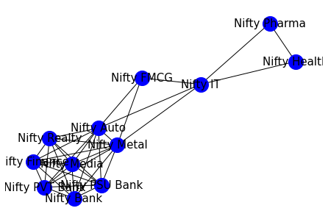
CORRELATED NETWORK
Threshold Value = 0.6
Threshold Value = 0.7

Slide 17
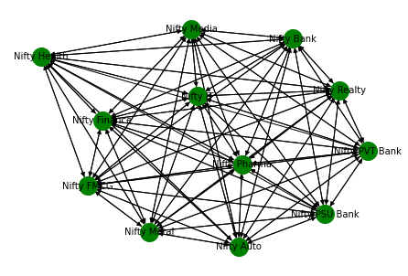
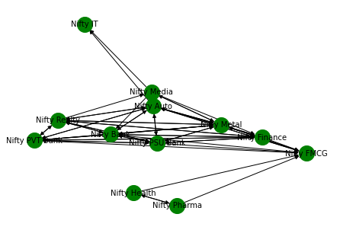
APRIORI NETWORK
Threshold Value = 0.7
Threshold Value = 0.8

Slide 18
CENTRALITY MEASURES
Centrality measurement is a good tool to find out which nodes are more important in the network.
Different Centrality measures like Degree, Closeness, Betweenness, Eigen Vector are used that are calculated for all the nodes of the networks that correspond to the market sectors.

Slide 19
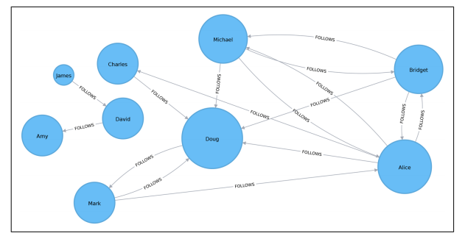
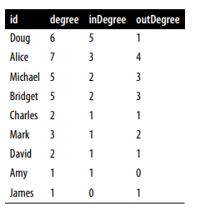
1. DEGREE CENTRALITY
It counts the number of incoming and outgoing relationships from a node, and is used to find popular nodes in a graph.
EXAMPLE : TWITTER NETWORK – To find the celebrity
Celebrity = Doug
has 5 followers
but only one following

Slide 20
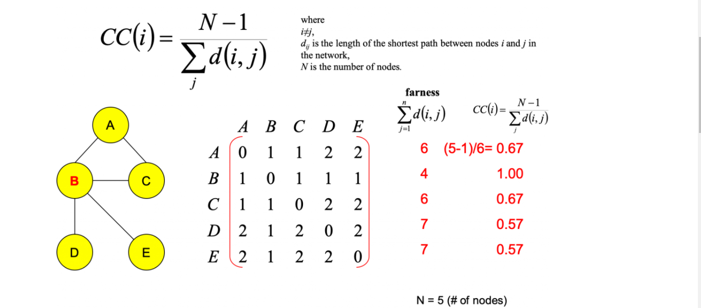
2. CLOSENESS CENTRALITY
Closeness Centrality is a way of detecting nodes that are able to spread information efficiently through a subgraph.
EXAMPLE : Calculating the closeness centrality of nodes in a graph.
Here, Node B is the Central Node.

Slide 21
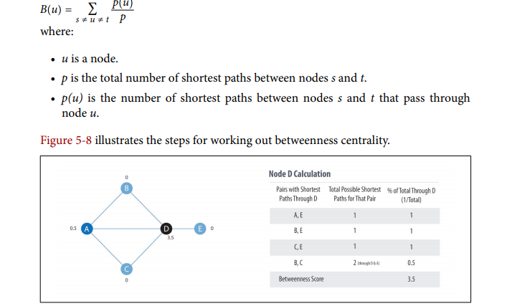
3. BETWEENESS CENTRALITY
Betweenness Centrality is a way of detecting the amount of influence a node has over the flow of information or resources in a graph. It is typically used to find nodes that serve as a bridge from one part of a graph to another.

Slide 22
4. EIGENVECTOR CENTRALITY
It assigns relative scores to all nodes in the network based on the concept that connections to high-scoring nodes contribute more to the score of the node in question than equal connections to low-scoring nodes.

Slide 23
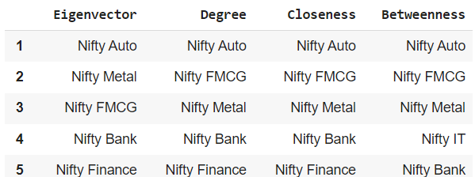
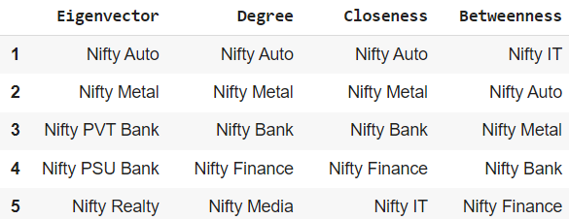
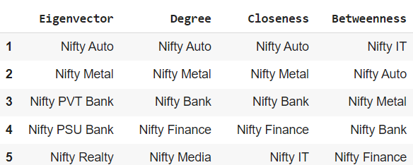
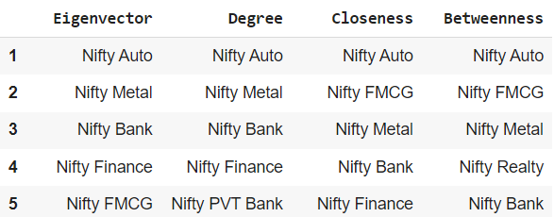
AFTER APPLYING CENTRALITY MEASURES
Correlated Network :
Apriori Network :
Threshold Value = 0.6
Threshold Value = 0.6
Threshold Value = 0.7
Threshold Value = 0.8

Slide 24
STOCK PREDICTION
Stock Prediction is done using LSTM(Long Short-Term Memory).
RNN(Recurrent Neural Network)
RNN works on the principle of saving the output of a particular layer and feeding this back to the input in order to predict the output of the layer.

Slide 25
LSTM (LONG SHORT-TERM MEMORY)
LSTMs are a special kind of RNN — capable of learning long-term dependencies by remembering information for long periods is the default behavior.
Workings of LSTMs in RNN
1. Decide How Much Past Data It Should Remember
2. Decide How Much This Unit Adds to the Current State
3. Decide What Part of the Current Cell State Makes It to the Output

Slide 26
STEPS IN LSTM
STEP 1 : import the libraries.
STEP 2 : import the dataset.
STEP 3 : Visualize the Data
STEP 4 : Drop Extra Columns
STEP 5 : Separate into Training and Testing Dataset.
STEP 6 : Scale the data.
STEP 7 : Separate into X_train and Y_train
STEP 8 : Build the LSTM Model.
STEP 9 : Compile the Model.
STEP 10 : Fit the Model.
STEP 11 : Predict the Testing Data
STEP 12 : Plot the Result

Slide 27
RESULT
PHASE 1 RESULT :
In correlation networks, the Nifty Auto sector shows more correlation with other sector indices. This results that if some could only see one sector to analyze the fluctuations of the Indian Stock Market(NSE), the Nifty Auto sector index showed a better behavior of the NSE than other sector indices.
PHASE 2 RESULT :
From the directed networks extracted from the association rules, it became clear that the Nifty Auto sector was the most influenced sector by other sectors price. This sector is affected by many of other sectors, meaning where they rise in value, the Nifty Auto sector also rises.

Slide 28
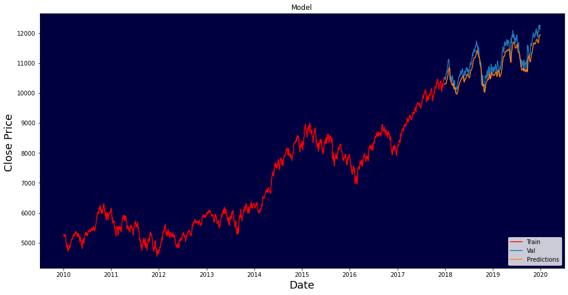
RESULT
PHASE 3 RESULT :
The Accuracy of LSTM in Predicting the Stock Price is 95.4%

Slide 29
CODE DEMO

Slide 30
NSE INDIA ANALYSIS A WEB APPLICATION

Slide 31
STREAMLIT
Streamlit is an open-source python framework for building web apps for Machine Learning and Data Science.
We can instantly develop web apps and deploy them easily using Streamlit.
Streamlit allows you to write an app the same way you write a python code.
Streamlit makes it seamless to work on the interactive loop of coding and viewing results in the web app.

Slide 32
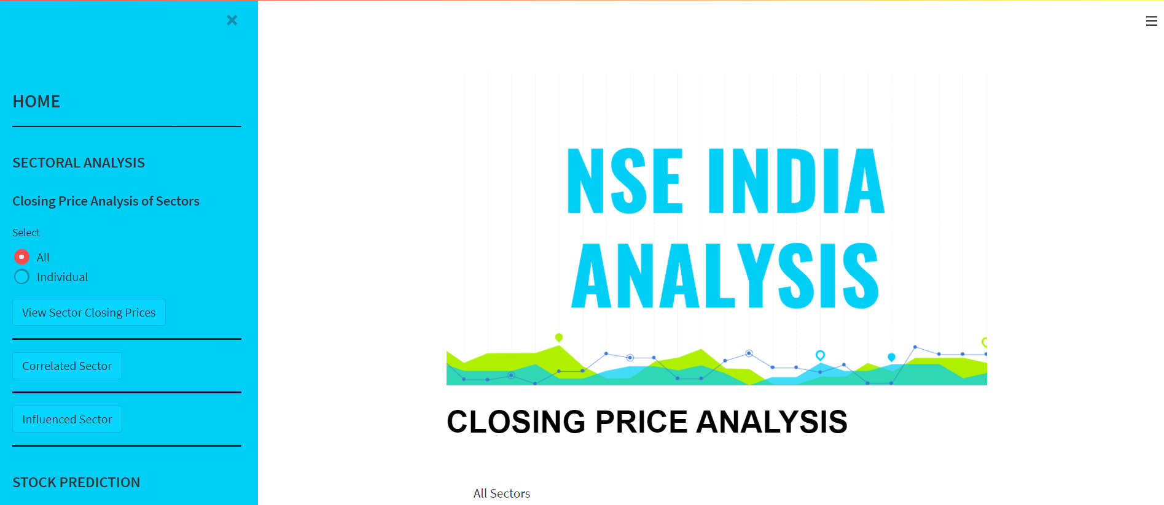

Slide 33
THANKS!

